Slide 1
Predictive Modelling
Applying machine learning models to analyse customer booking data.

Slide 2
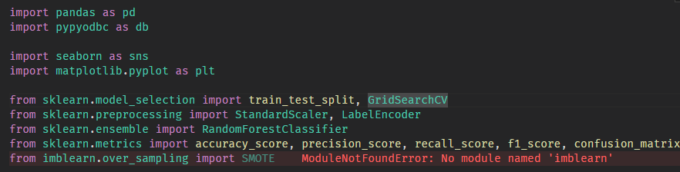
Import Necessary Libraries
For this web scraping process, we need 3 python libraries :
Pandas : For data manipulation
Pypyodbc : ODBC connection for python and Microsoft SQL Server
Seaborn & Matplotlib : For data visualization
Scikit-learn : Libraries for machine learning models

Slide 3
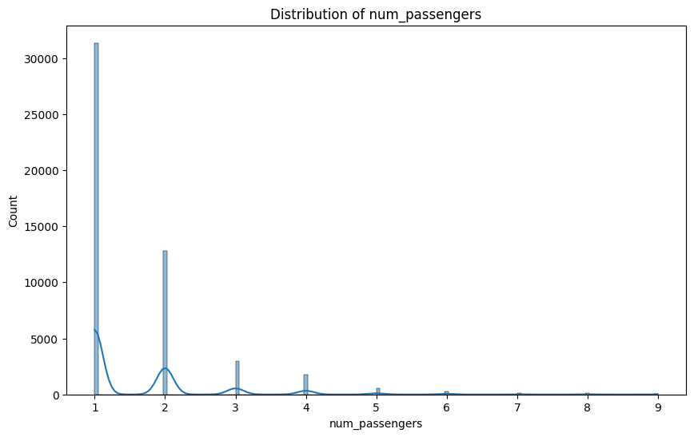
Exploratory Data Analysis (EDA)
This data distribution of the number of passengers shows that most of the passengers buys one seat.

Slide 4
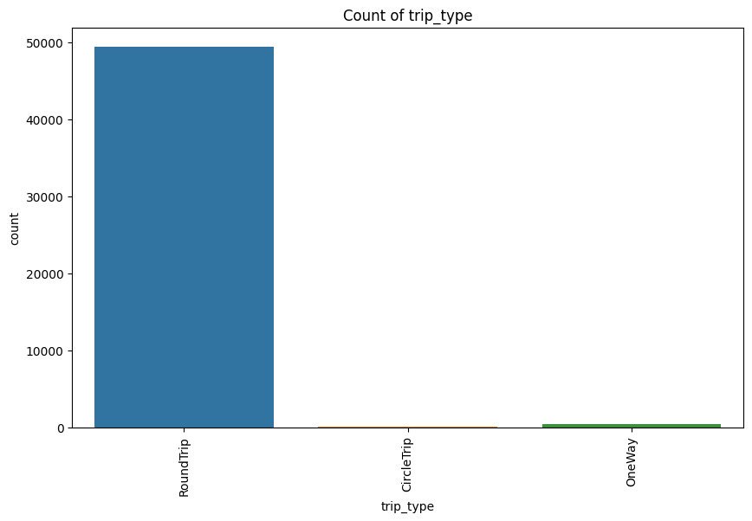
Exploratory Data Analysis (EDA)
This graph shows that majority of the British Airways Customers are having a roundtrip, other than Circle Trip or One Way. Indicating that most customers are a tourists

Slide 5
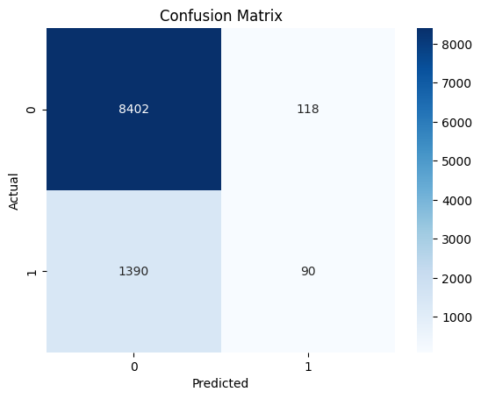
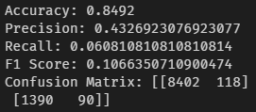
Predictive Modelling
Now we began to applying machine learning model into our data, this suggests that the model has high true negatives and low true positives, indicating it's better at predicting the majority class (0) rather than the minority class (1).

Slide 6
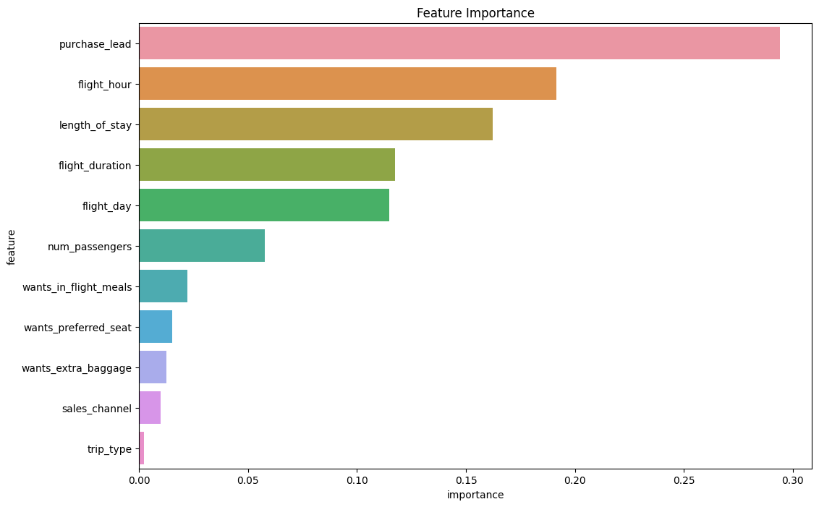
Feature Importances
Top Features: purchase_lead, flight_hour, and length_of_stay are the top three most important features. These should be the focus when thinking about customer behavior and strategies to improve booking completion rates.

